Slide 1
Qt Quick Application Using Qt Rendering
V1.0

Slide 2
Improve Qt skill by achieving these:
Understanding Qt Scene Rendering
Customize rendering of QQuickItem
Qt supported node type
QML Rendering object

Slide 3
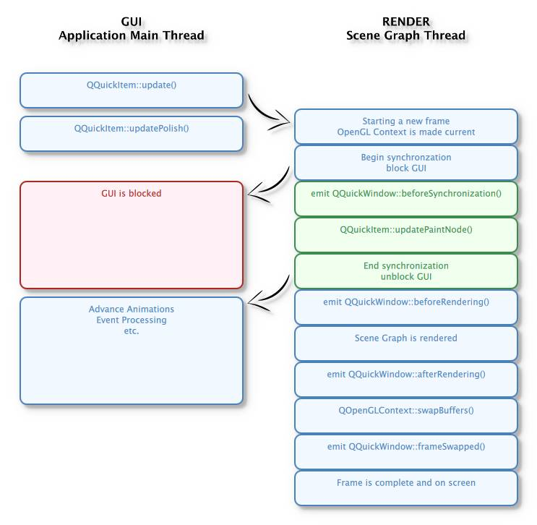
Understanding Qt Scene Graph
Currently, Qt will rendering in other thread than main thread.
Increase parallelism of multi-core processors
Offers significant performance improvements
Note: we should prevent any dump code in this process because it essentially affected to UX

Slide 4
Customize rendering of QQuickItem
Things to memorize:
Every QML are based on C++, our custom object will also is C++ which inherited QQuickItem class. QQuickItem is equivalent to Item object on QML.
Each QQuickItem will have updatePaintNode & releaseResource method for rendering process. We will customize these methods to control how QML will render our object.
“Node” stands for a layer in QQuickItem.
Each “Node” can have many child “Node”
(3)
(Child 2)
(Child 1)
(Node)

Slide 5
Customize rendering of QQuickItem
Things to memorize:
We should keep level of “Node” is lower than 2 to prevent complexity code & object control.
If we need many child “Node” level, let’s separate them into many custom QQuickItem objects.
SoSimpleItem class
(3)
DumpComplex class
(Child 2)
(3)
(Child 2)
(Child 1)
(Node)
MuchSimpleItem class
(Child 1)
(Node)

Slide 6
Customize rendering of QQuickItem
What are “Node” actually ?
We can imagine “Node” as an empty transparent rectangle on QML
By using “Node” (or QSGNode class), Qt will understand that this object is rendered and drawn by OpenGL.
Each “Node” will have a Geometry and a Material
Vertex (x,y)
Geometry
Includes X,y, rotation,
translation
Vertex (x,y)
Node
Vertex
(x,y)
T
Material
T
Vertex (x,y)
Includes color, image,
shader, etc
“T” texture
Example of display “T” image

Slide 7
Customize rendering of QQuickItem
How we work better & easier with “Node” ?
QSGNode is base class for every “Node” type
QSGMaterial is base class for every material type
QSGGeometry is base class for every geometry type
We will have to code a lot if we use these class. Qt have a lot of pre-defined Node / Material / Geometry, which we will have to input fewer required data for custom objects. Example:
QSGImageNode: handle an image inside a rec => we only have to input image and bounding rectangle (see Qt Docs for supported properties)
QSGRectangleNode: handle a rectangle => we only have to input bounding rectangle data(see Qt Docs for supported properties)
etc

Slide 8
Customize rendering of QQuickItem
Things to memorize:
We should keep level of “Node” is lower than 2 to prevent complexity code & object control.
If we need many child “Node” level, let’s separate them into many custom QQuickItem objects.
SoSimpleItem class
(3)
DumpComplex class
(Child 2)
(3)
(Child 2)
(Child 1)
(Node)
MuchSimpleItem class
(Child 1)
(Node)

Slide 9
Customize rendering of QQuickItem
Things to memorize:
We should keep level of “Node” is lower than 2 to prevent complexity code & object control.
If we need many child “Node” level, let’s separate them into many custom QQuickItem objects.
SoSimpleItem class
(3)
DumpComplex class
(Child 2)
(3)
(Child 2)
(Child 1)
(Node)
MuchSimpleItem class
(Child 1)
(Node)

Slide 10
Customize rendering of QQuickItem
VertexList
Let’s go deeper:
These are OpenGL
contexts
QSGGeometry
DrawingMode
QSGNode
QSGTexture
QQuickItem
QSGMaterial
QSGMaterial
QSGMaterial
UpdatePaintNodeData
Input data
vertexShader
QSGMaterialShader
These are properties of Node,
we rarely change it, so we can ignore it
fragmentShader
QSGMaterialType

Slide 11
Customize rendering of QQuickItem
Essential things that will kill us:
- Each custom object must have “setFlag(ItemHasContents, true);” line in constructor
- Each time QML re-draw item, we can modify current node (not referred) or add new node (and old node will be removed or it will leak memory)
- Every time we changed Geometry / Material / Texture / etc of Node. No-need to re-create them all, we just need to use FLAG. With Flags, Qt will know which context was modified and redraw it.
Ex: QSGNode::DirtyMaterial => material is changed
- “Owns” flag can be used to determine child context will be deleted with parent context or not. It really helps us control the memory leak. Ex: QSGNode::OwnsGeometry => Geometry context will be deleted when node is deleted.
- Use custom shader code will have best performance (or worst if we are stupid for it), and it also take much effort. Consider it carefully before using shader if we do not master in OpenGL

Slide 12
LET’S MAKE SAMPLE WITH SAMPLE SOURCE CODE

Slide 13
Custom Thread
It is not recommended for simple threading application
To execute thread, we have to create a class inherited from QThread and modify “run()” method. For example:
Define:
class UserThread : public QThread {
protected:
void run() { /* implementation of thread */ }
};
Usage:
UserThread *t = new UserThread ;
t->start();

